Slide 1
React JS
Chahat Uppal
Manisha Sharma

Slide 2
Agenda (Day 1)
ES6 Features
What is React ?
Installation
Basic React JS Features

Slide 3
ES6 Features
Definition:
ES6 or ECMAScript 2015 is the 6th version of the ECMAScript programming language.
ECMAScript is the standardization of JavaScript which was released in 2015 and subsequently renamed as ECMAScript 2015.
Purpose
To provide new features and improvements to JavaScript.
To make JavaScript more powerful, easier to write, and more efficient.
Why ES6
Addresses limitations of previous versions.
Enhances readability, functionality, and performance.

Slide 4
ES6 Features
let and const Keywords
Arrow Functions
Template Literals
Destructuring Assignment
Rest and Spread Operators
Classes
constructor
Inheritance
Module (Import/Export)

Slide 5
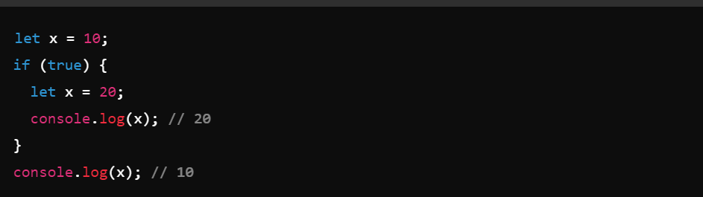
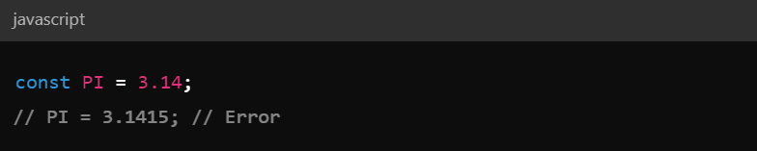
Let and Const
Let : -
Block-scoped variable declaration.
Example
Const:-
"const" used to define constants
Constants are similar to let variables, except that the value cannot be changed.

Slide 6
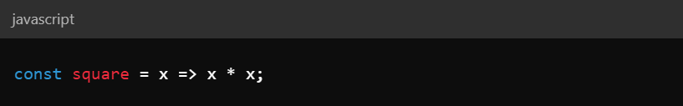
Arrow Functions
Definition
Arrow functions are a concise syntax for writing function expressions in JavaScript.
Arrow functions are defined using the fat arrow (=>) notation.
Syntax of Arrow Functions
Basic Syntax:
Single parameter:

Slide 7
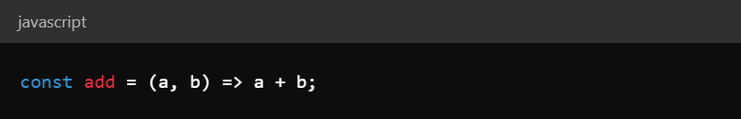
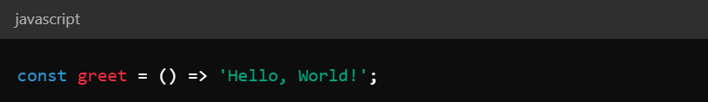
Arrow Functions
Multiple Parameters:
No Parameters:

Slide 8
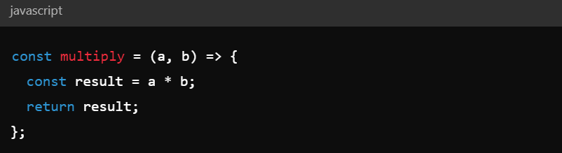
Block Body Syntax (for multiple statements):
With return statement:

Slide 9
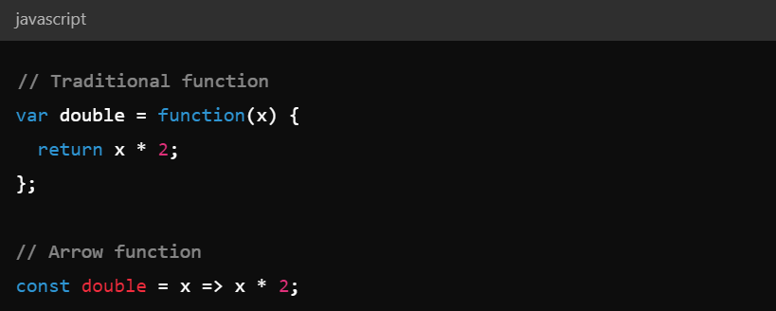
Benefits of Arrow Function
Concise Syntax:
Reduces the amount of boilerplate code.
Example:

Slide 10
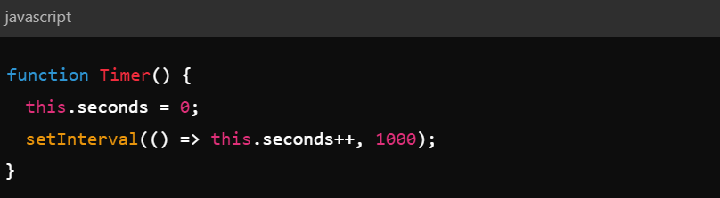
Lexical this Binding:
Arrow functions do not have their own this context; they inherit this from the surrounding lexical context
Example:

Slide 11
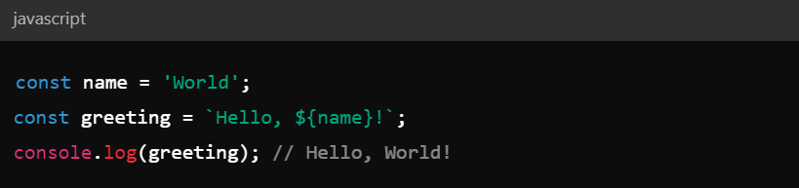
Template Literals
String Interpolation:
Embed expressions and multi-line strings.
Example:

Slide 12
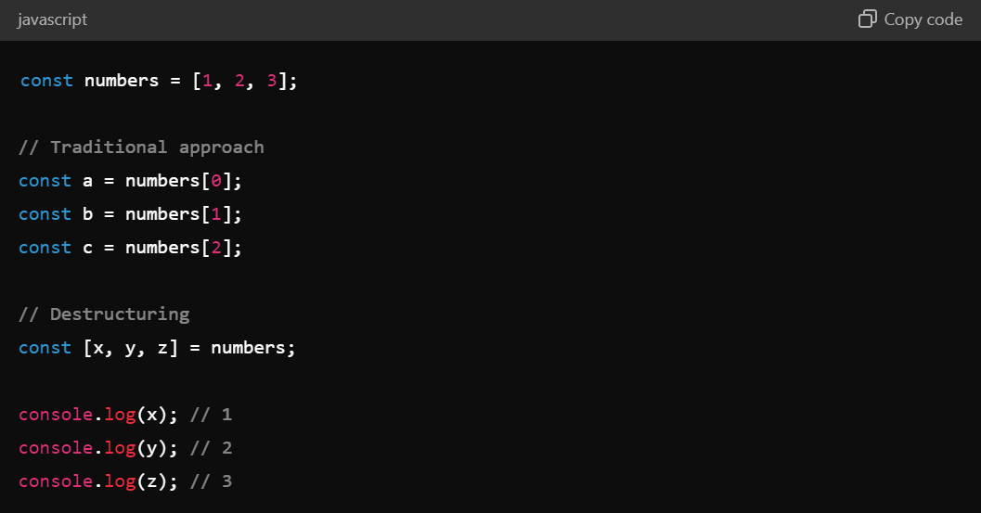
Destructuring Assignment
The destructuring assignment syntax is a JavaScript expression that makes it possible to unpack values from arrays, or properties from objects, into distinct variables.
Array Destructuring:
Allows unpacking values from arrays into distinct variables.
Example

Slide 13
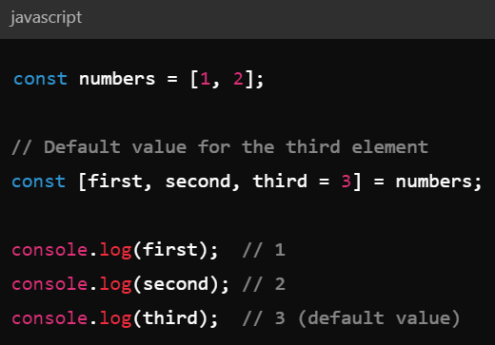
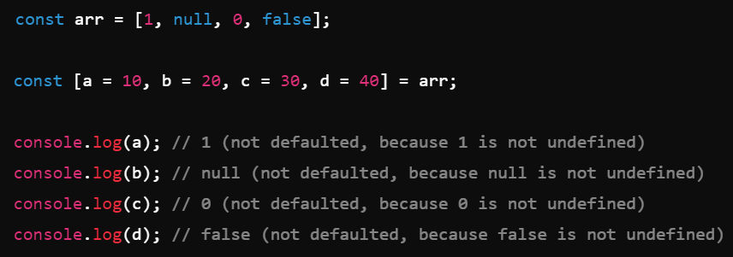
Default Values in Array Destructuring
Default values are used to assign a value when the array does not contain enough elements.
Basic Default Values Default Values with Falsy Values

Slide 14
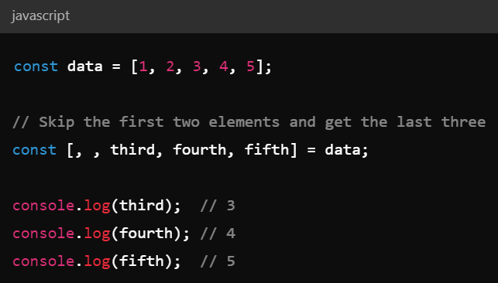
Skip Elements using Array Destructuring
You can skip elements in an array by leaving an empty slot in the destructuring pattern.
Example

Slide 15
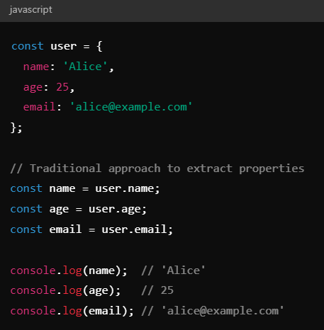
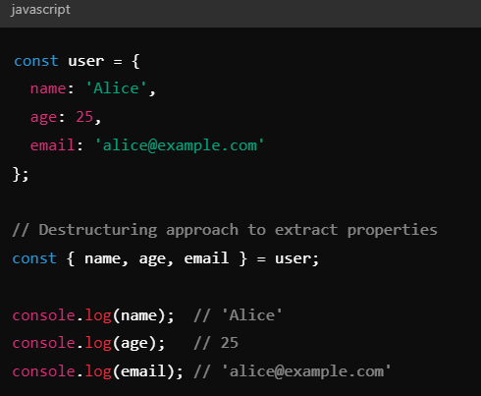
Object Destructuring:
Object Destructuring is the syntax for extracting values from an object property and assigning them to a variable.
Traditional Approach Object Destructuring

Slide 16
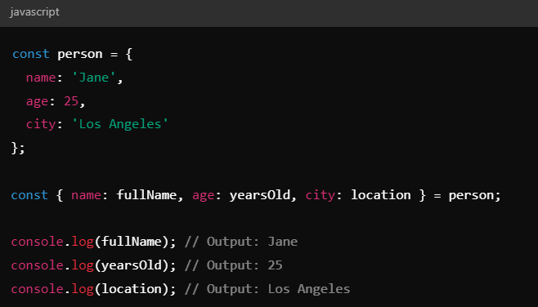
Renaming Variables using Object Destructuring
Object destructuring also allows to rename variables by using a colon (:) to specify a new variable name.
Example:

Slide 17
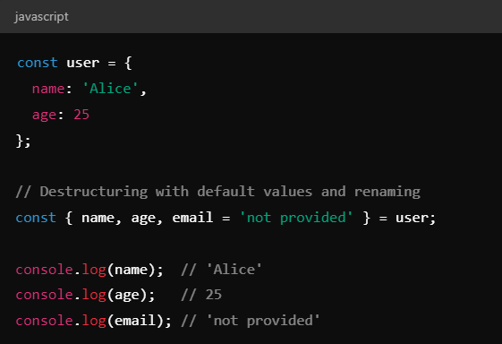
Default Values using Object Destructuring
Object destructuring also allows for setting default values in case the property is undefined.
Example:

Slide 18
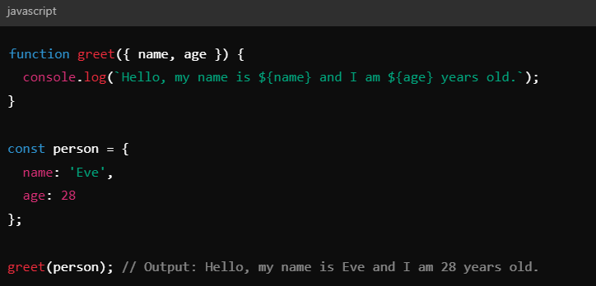
Destructuring with Functions
You can use object destructuring in function parameters to make the code cleaner.
Example:

Slide 19
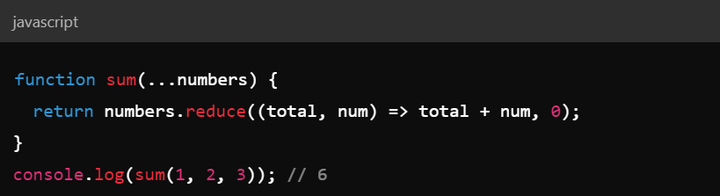
Rest Operator (…)
Rest Operator (...):
Collect multiple arguments into an array.
Example:

Slide 20
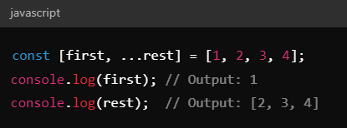
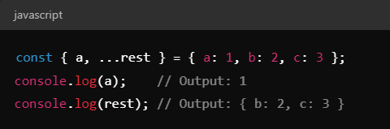
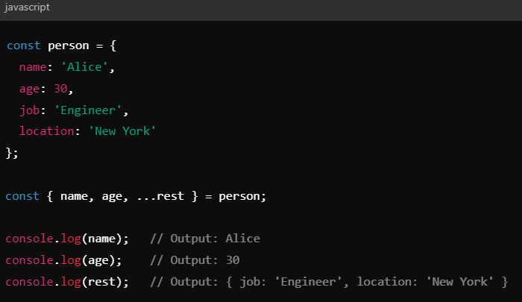
Rest Operator in Destructuring
Array Destructuring: Object Destructing

Slide 21
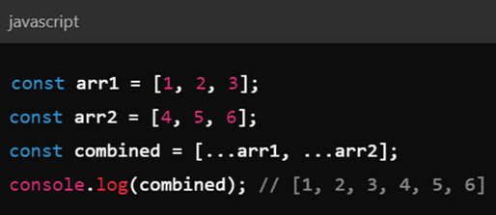
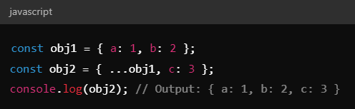
Spread Operator (…)
Expand elements of an array or object.
Example:
Array Literals Object Literals

Slide 22
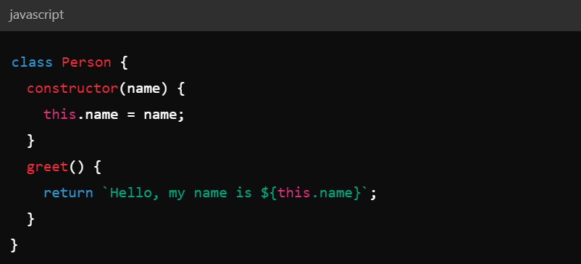
Classes
A class is a type of function, but instead of using the keyword function to initiate it, we use the keyword class, and the properties are assigned inside a constructor() method.
Example
Class Definition:

Slide 23
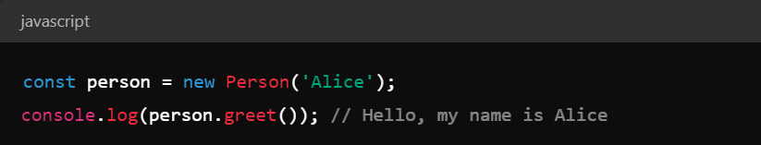
Creating an Instance:
Example:

Slide 24
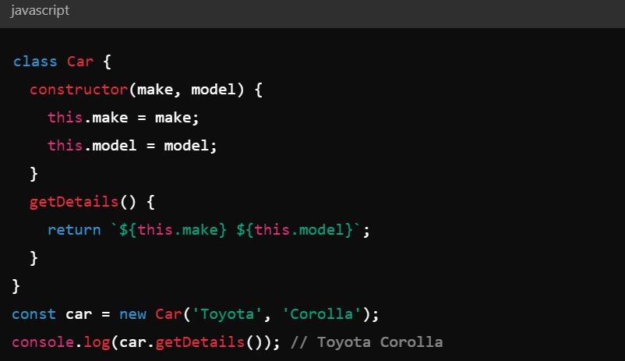
Constructors
Purpose:
Have the exact name "constructor"
Executed automatically when a new object is created
used to initialize object properties
Example:

Slide 25
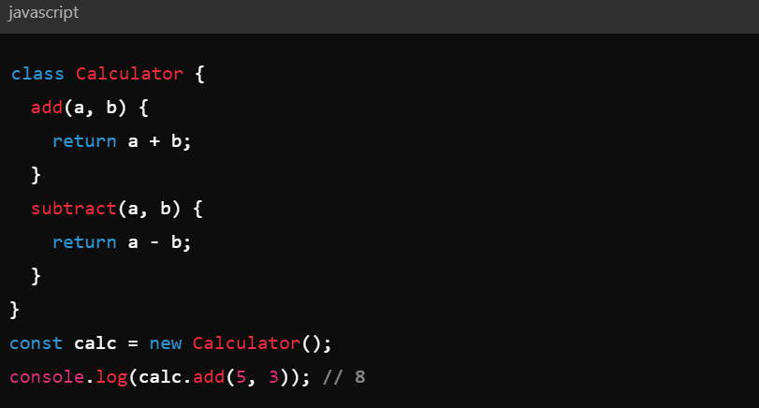
Methods in Classes
Instance Methods:
Defined directly within the class.
Example:

Slide 26
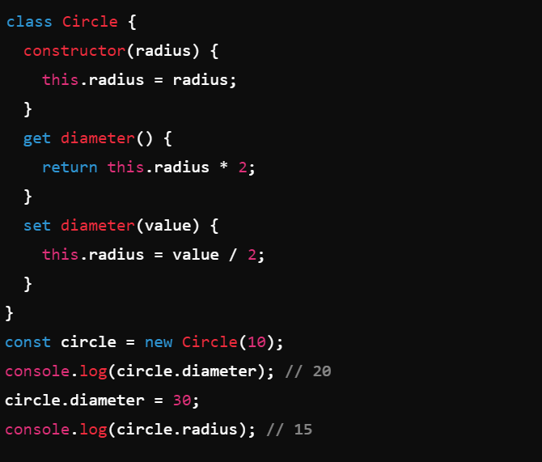
Getter and Setter Methods:
Accessor properties for class instances.
Example:

Slide 27
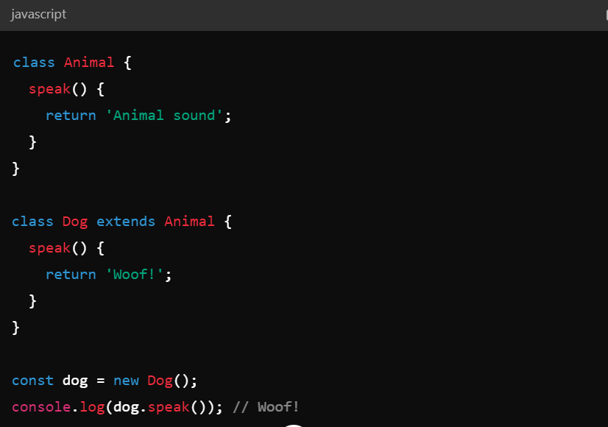
Inheritance in ES6 Classes
To create a class inheritance, use the extends keyword.
A class created with a class inheritance inherits all the methods from another class.
Extending Classes:
Example:

Slide 28
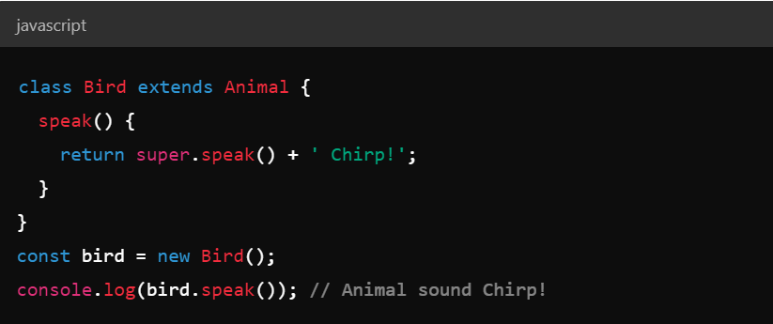
Using Super
Call methods from the parent class.
Example:

Slide 29
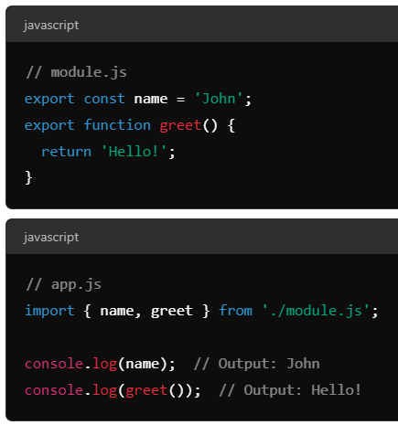
Modules (import/export)
ES6 introduced a new feature called modules, in which each module is represented by a separate ".js" file.
use the "import" or "export" statement in a module to import or export variables, functions, classes or any other component from/to different files and modules.
Named Imports:
Importing specific values from a module.

Slide 30
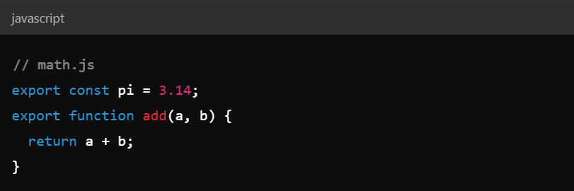
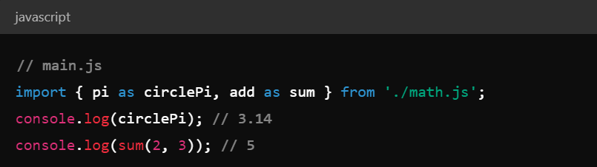
Renaming Imports
Renaming Named export
Example:-
Renaming Imports and Exports
Example:-

Slide 31
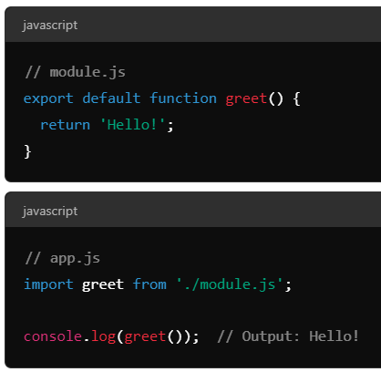
Default Import/Export
Importing the default export from a module.
Example:

Slide 32
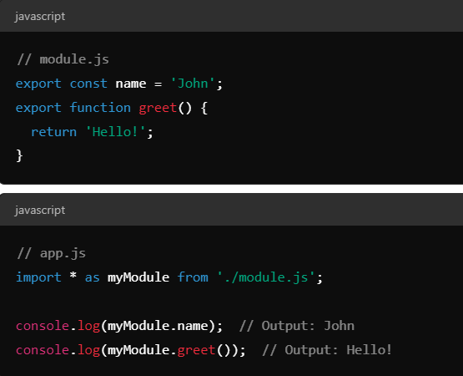
Import All
To import all named exports from a module
as a single object, use the * as syntax.
Example:-

Slide 33
React 18 Basics
JSX
Functional and class-based components
Props and state management
Event handling
Lists and keys
Forms
Conditional rendering
Routing
State lifting

Slide 34
What is React JS?
React is a free and open-source front-end JavaScript library for building user interfaces based on UI components.
It is created by Facebook.
How to Use ?
React. JS is an open-source JavaScript library that is used for building user interfaces specifically for single-page applications.
It's used for handling the view layer for web and mobile apps.
React also allows us to create reusable UI components.

Slide 35
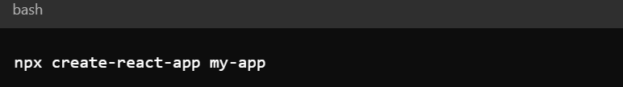
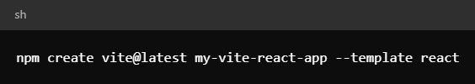
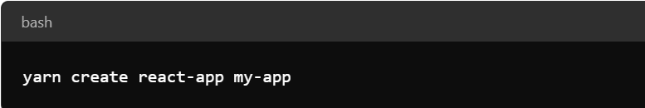
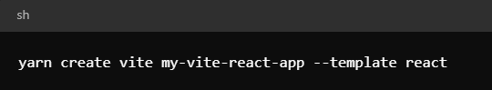
React Environment Setup
There are two ways to set up an environment for successful ReactJS application. They are given below.
Using the npm /yarn command
Using the create-react-app/vite command

Slide 36
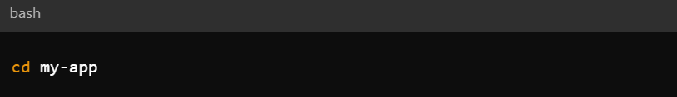
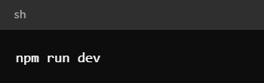
Start the Development Server
Navigate to Project Directory:
Run the Server:

Slide 37
Advantages of React
Speed
Flexibility
Performance
Usability
Reusable Components
It helps to build rich user interfaces
It allows writing custom components

Slide 38
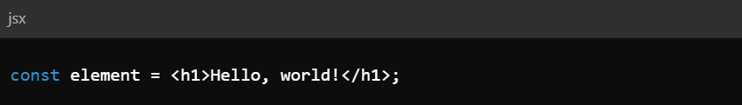
What is JSX?
JSX (JavaScript XML) is a syntax extension for JavaScript that allows writing HTML-like code within JavaScript files.
JSX helps us to write HTML in JavaScript and forms the basis of React Development.

Slide 39
Why JSX?
It is faster than normal JavaScript as it performs optimizations while translating to regular JavaScript.
It makes it easier for us to create templates.
Instead of separating the markup and logic in separate files, React uses components for this purpose. We will learn about components in detail in further articles.
As JSX is an expression, we can use it inside of if statements and for loops, assign it to variables, accept it as arguments, or return it from functions.

Slide 40
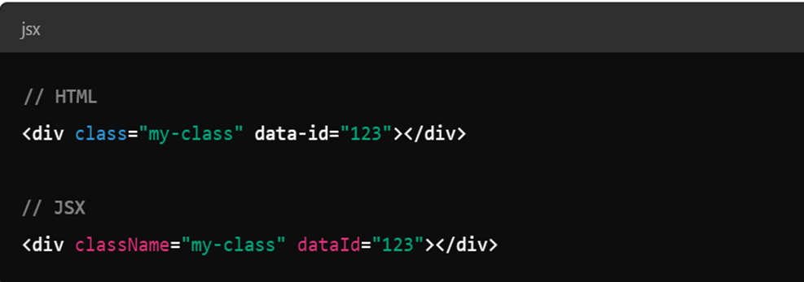
Expressions in JSX
JSX attributes are used to set properties on React elements, similar to HTML attributes but with some differences.
The change of class attribute to ‘className’.
Creation of custom attributes

Slide 41
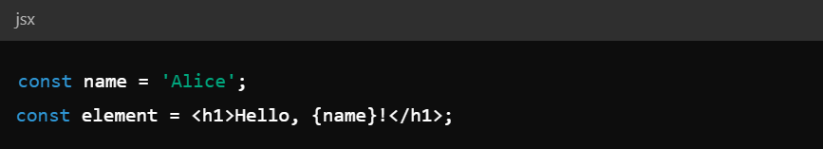
JSX Attributes
To embed any JavaScript expression in a piece of code written in JSX we will have to wrap that expression in curly braces {}.

Slide 42
Rules to Write JSX
Always return a single Root Element: When there are multiple elements in a component, and you want to return all of them wrap them inside a single component
Close all the tags: When we write tags in HTML some of them are self closing like the <img> tag but JSX requires us to close all of them so image tag will be represented as <img />
Use camelCase convention wherever possible: When writing JSX if we want to give class to a tag, we must use the className attribute which follows camelCase convention.

Slide 43
ReactJS Babel Introduction
Babel is a very famous transpiler that basically allows us to use future JavaScript in browsers.
It can convert the latest version of JavaScript code into the one that the browser understands.
ReactJS Virtual DOM
React JS Virtual DOM is an in-memory representation of the DOM. DOM refers to the Document Object Model that represents the content of XML or HTML documents as a tree structure so that the programs can be read, accessed and changed in the document structure, style, and content.

Slide 44
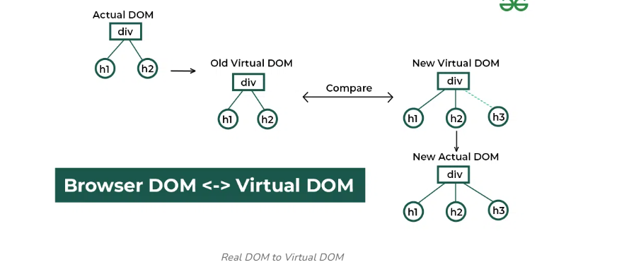
Virtual DOM works
Step 1 – Initial Rendering
Step 2 – State and Props Changes
Step 3 – Comparison Using Diff Algorithm
Step 4 – Reconciliation Process
Step 5 – Update to the Real DOM

Slide 45
React Components
React Components are the building block of React Application.
They are the reusable code blocks containing logics and, and UI elements.
They have the same purpose as JavaScript functions and return HTML.
Components make the task of building UI much easier.

Slide 46
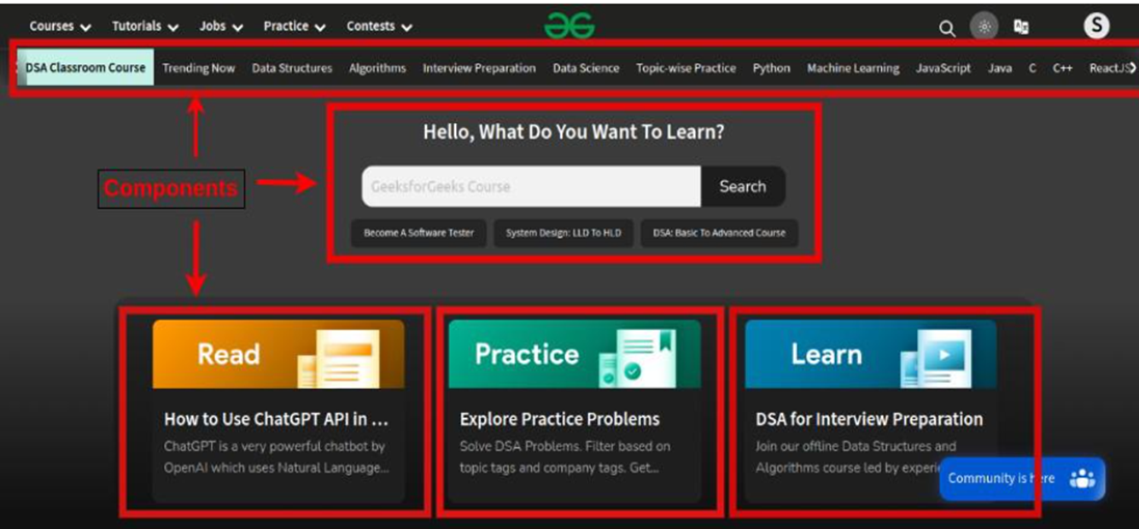
A UI is broken down into multiple individual pieces called components. You can work on components independently and then merge them all into a parent component which will be your final UI.

Slide 47
Types of Components in React
In React, we mainly have two types of components:
Functional Components
Class based Components

Slide 48
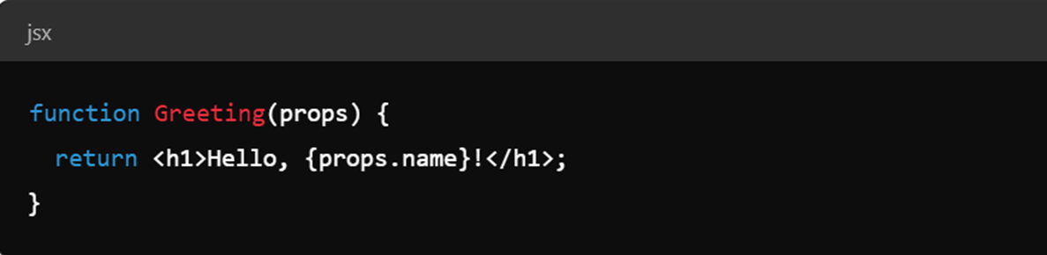
Functional Component in React
Functional components are just like JavaScript functions that accept properties and return a React element. Syntax :

Slide 49
Class Component in React
The class components are a little more complex than the functional components.
A class component can show inheritance and access data of other components.
Limitations of class components in React:
- Confusing ‘this’ Binding
- Performance Concerns - Limited Lifecycle Methods - Limited Reusability

Slide 50
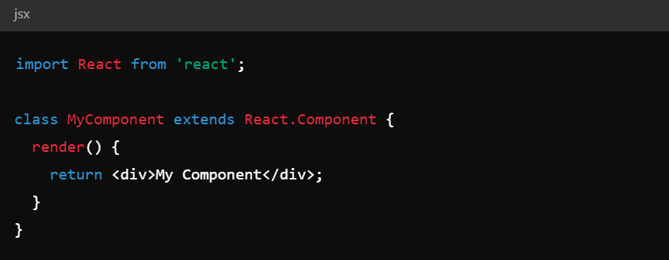
Syntax of Class Component
Class Component must include the line “extends React.Component” to pass data from one class component to another class component.

Slide 51
Class Component in React
The class components are a little more complex than the functional components.
A class component can show inheritance and access data of other components.
Class Component must include the line “extends React.Component” to pass data from one class component to another class component
Class components also known as stateful components contain state and lifecycle methods and are written with JavaScript ES6 classes.
A state is an object that contains data that can be updated and displayed in the component.

Slide 52
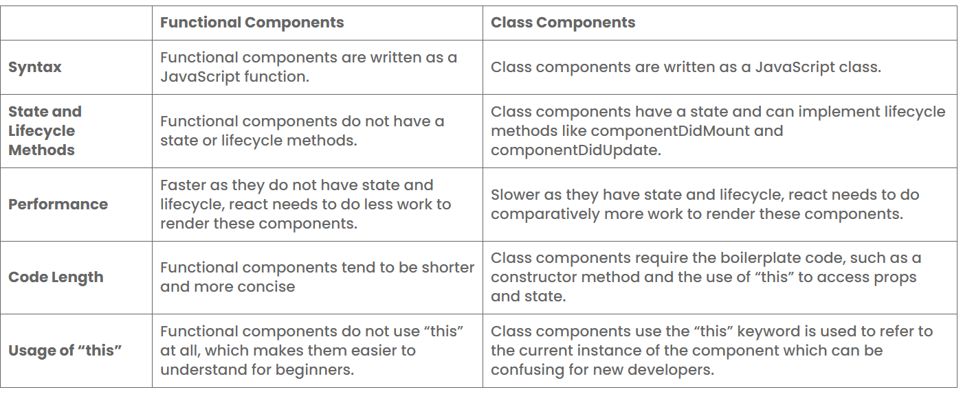
Functional Components vs. Class Components

Slide 53
Props and state management
What is props?
React allows us to pass information to a Component using something called props (which stands for properties).
Props are objects which can be used inside a component.
Key Concepts of Props
Data Transfer
Read-Only
Functionality
Customization

Slide 54


Passing and Accessing props
We can pass props to any component as we declare attributes for any HTML tag.
We can access any props inside from the component’s class to which the props is passed.

Slide 55
Default Props
The default Props is a React component property that allows you to set default values for the props argument.
If the prop property is passed, it will be changed.
The default Props can be defined as a property on the component class itself, to set the default props for the class.

Slide 56

Default props in React class components

Slide 57


PropTypes
create strict rules for the data being passed in the props.
Before the release of React 15.5.0 version propTypes was available in the react package but in later versions of React have to add a dependency in your project. You can add the dependency to your project by using the command given below:

Slide 58

Syntax of propTypes

Slide 59

ReactJS State
The State is a way to store and manage the information or data while creating a React Application.
The state is a JavaScript object that contains the real-time data or information on the webpage.
Creating State Object
Creating a state is essential to building dynamic and interactive components.
We can create a state object within the constructor of the class component.

Slide 60

Updating State in React
State object can be updated using setState() method. Example:

Slide 61

Difference between props and state

Slide 62
React Events
React Events are user interactions with the web application, such as clicks, keyboard input, and other actions that trigger a response in the user interface. Event declaration in react is different from HTML, React uses:
the camelCase convention instead of lowercase letters.
JSX is used in react instead of plain html.

Slide 63


Event Declaration in HTML
Event Declaration in React:

Slide 64

Commonly Used React Event Handlers

Slide 65
React List
React Lists are mainly used for displaying menus on a website, for example, the navbar menu.
We can create lists in React just like we do in regular JavaScript i.e. by storing the list in an array.
To traverse a list we will use the map() function.
To create a React list, follow these given steps:
Step 1: Create a list of elements in React in the form of an array and store it in a variable.
Step 2: We will then traverse the list using the JavaScript map() function and update elements to be enclosed between <li> </li> elements.
Step 3: Finally, we will wrap this new list within <ul> </ul> elements and render it to the DOM.

Slide 66

Example

Slide 67
React JS Keys
React JS keys are a way of providing a unique identity to each item while creating the list of elements. Keys allow React to keep track of elements. This way, if an item is updated or removed, only that item will be re-rendered instead of the entire list.

Slide 68

Example

Slide 69

React Form
React Forms are the components used to collect and manage the user inputs. These components includes the input elements like text field, check box, date input, dropdowns etc.
React typically utilize controlled components to manage form state and handle user input changes efficiently.

Slide 70
Controlled Components
A component whose form data is controlled by React state, meaning its value is derived from props and updates are managed via callbacks.

Slide 71


Conditional rendering
In React, you can conditionally render JSX using JavaScript syntax like if statements, &&, and ? : operators.
1. Using if statements

Slide 72


Conditional rendering
2. Using Ternary Operators
3. Using Logical AND (&&) Operator

Slide 73


Routing (react-router-dom)
Routing in React applications is primarily handled using the ‘react-router-dom’ library, which allows you to manage navigation and rendering of different components based on the URL.
Installation
First, you'll need to install react-router-dom using npm or yarn.

Slide 74


Router Setup in Project
Import the necessary components:
Create your component pages:

Slide 75

Router Setup in Project
3. Set up the Router in your main App component:

Slide 76

Dynamic Routing
To handle dynamic routes, route parameters
can be used.
Example:-
:userId is a route parameter, and you can
access it in your component using the
useParams hook.

Slide 77

Navigation
To navigate programmatically or through links, use Link or NavLink components:

Slide 78
State Lifting
State lifting refers to the practice of moving state to a common ancestor component when multiple components need to share or synchronize that state.
This is often done to ensure that the state is managed in a single place, which helps to maintain a predictable flow of data and makes it easier to reason about the state changes.
How to Lift State
Identify the Common Ancestor.
Move State Up
Update Children

Slide 79


Example :- Two sibling components that need to share the same state Without Lifting State With State Lifting

Slide 80
Advanced React 18
useState
useEffect
useContext
useRef
useReducer
useLayoutEffect
useMemo

Slide 81

useState
It allows you to add state variables to your functional components, making it easier to manage and track changes in your component's data.
Importing useState :- First, you need to import useState from the react package.
Using useState
To use useState, you call it within your functional component. It returns an array with two elements:
The current state value.
A function to update that state.

Slide 82

useState Example

Slide 83

useEffect
useEffect is a hook that lets you perform side effects in function components.
Side effects are operations that interact with the outside world, such as fetching data, updating the DOM, or setting up subscriptions. There are three variation in UseEffect hook:
useEffect without dependencies
useEffect with an empty array
useEffect with variables

Slide 84

useContext
The React useContext hook allows components to access data from a React context without having to pass props manually at every level. Why we need useContext Hook:

Slide 85
Create Context requires 3 steps
Creating the context
Providing the context
Consuming the context

Slide 86

useRef
The useRef Hook allows you to persist values between renders.
It can be used to store a mutable value that does not cause a re-render when updated.
It can be used to access a DOM element directly.

Slide 87
useReducer
The useReducer hook in React is a more advanced alternative to useState for managing state in functional components. It is especially useful when dealing with complex state logic or when the next state depends on the previous state.
The reducer function contains your custom state logic and the initialState can be a simple value but generally will contain an object.
The useReducer Hook returns the current stateand a dispatch method.

Slide 88

useLayoutEffect
The useLayoutEffect hook in React is similar to useEffect but it runs synchronously after all DOM mutations. It is used when you need to perform DOM measurements or manipulations that should happen before the browser has a chance to paint, ensuring that the layout changes occur immediately and are reflected before the browser renders the updates to the user.

Slide 89

useMemo
The useMemo hook is a part of React's Hooks API and is used to optimize performance by memoizing the result of a calculation or a function. This means that useMemo will only recompute the result when one of its dependencies changes. This can help prevent unnecessary recalculations and renderings, improving the performance of your application.

Slide 90
Thank you
Chahat Uppal
Manisha Sharma

